Slide 1
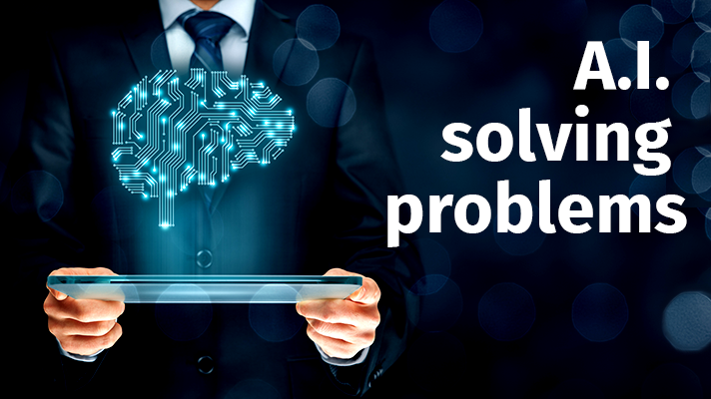
Automatic ANSWER CHECKER
Presented by :
Rashid Rahim (9715)
Mustansir Abbasi (9924)
Ayaz Qureshi (9910)
Notes:
NOTE:
To change the image on this slide, select the picture and delete it. Then click the Pictures icon in the placeholder to insert your own image.

Slide 2
Goal
Develop a program to check correct answer
Idea of grading in an unique criteria
Notes:
NOTE:
To change the image on this slide, select the picture and delete it. Then click the Pictures icon in the placeholder to insert your own image.

Slide 3
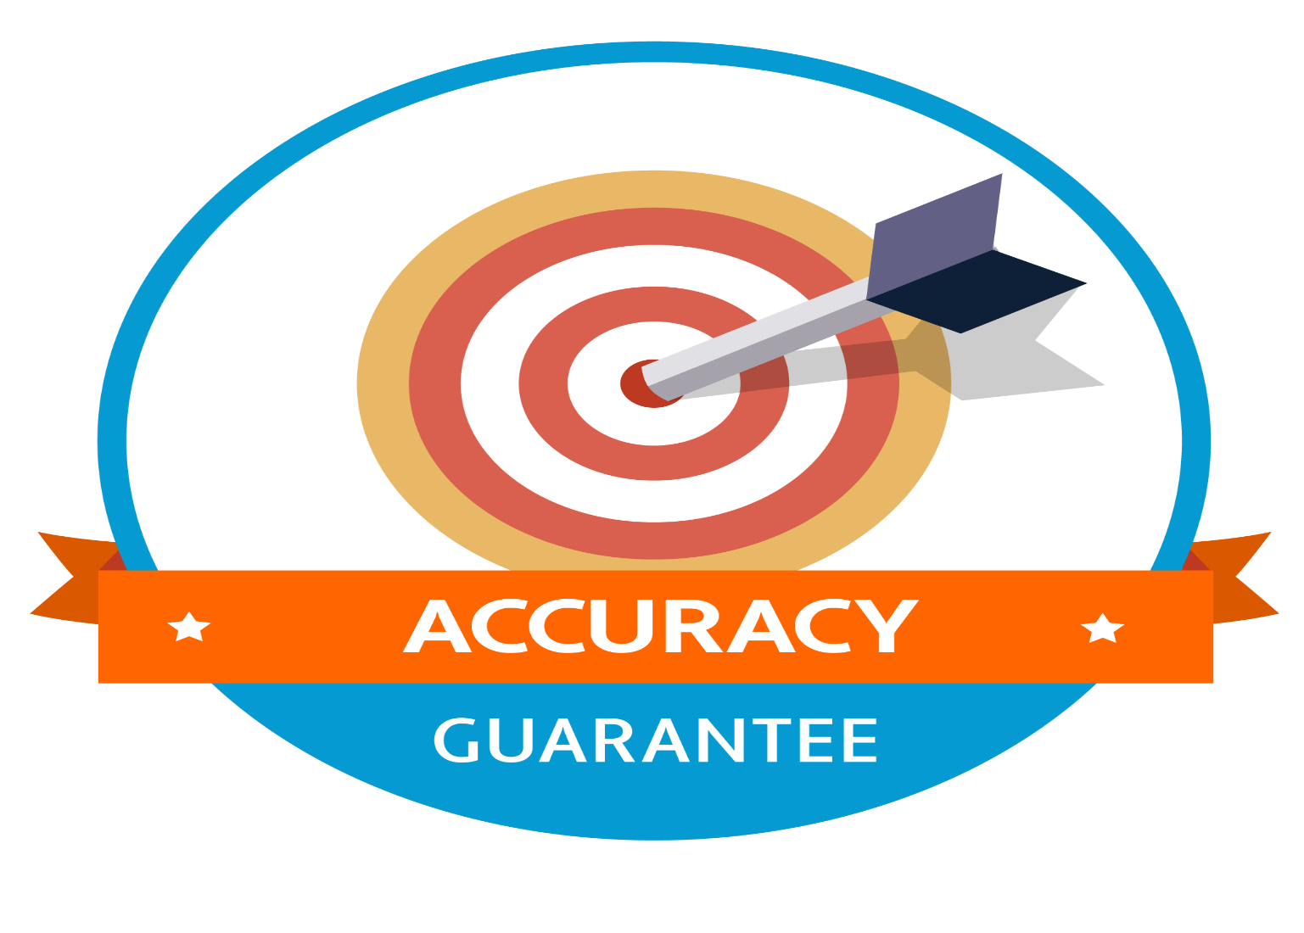
Application
Academic Revolution
100% Accurate result
No Mistake in Checking
Also a Program can not biased

Slide 4
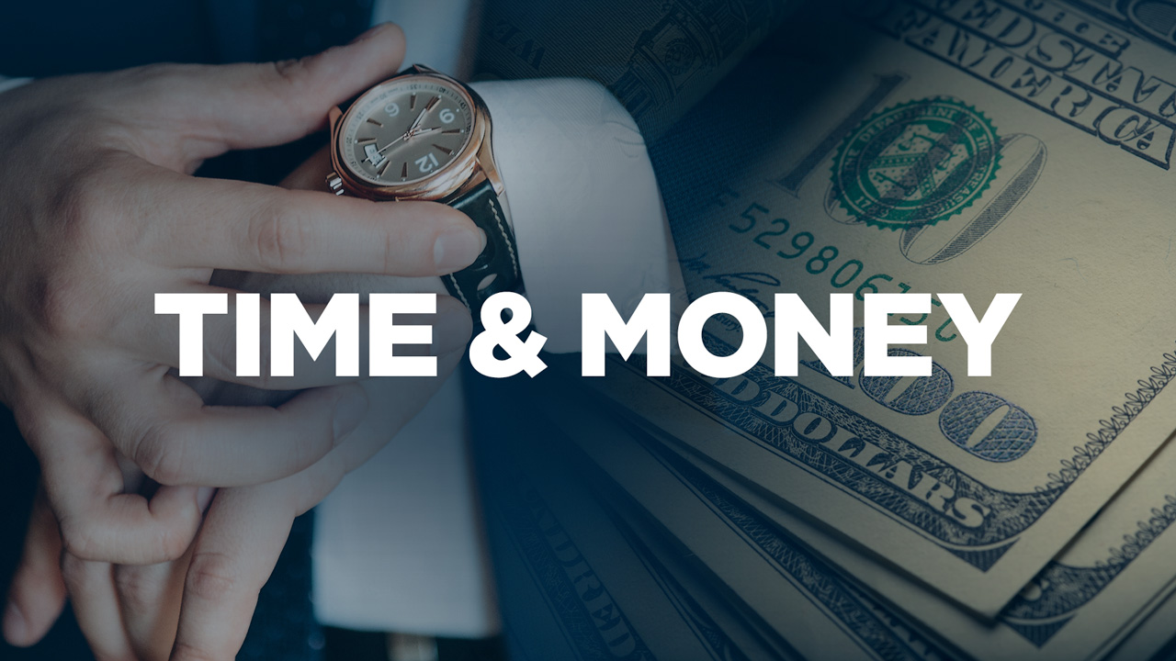
Application
2.Save Precious Time
Faculty can do more in utilized time
Important Person has more to do instead of checking papers

Slide 5
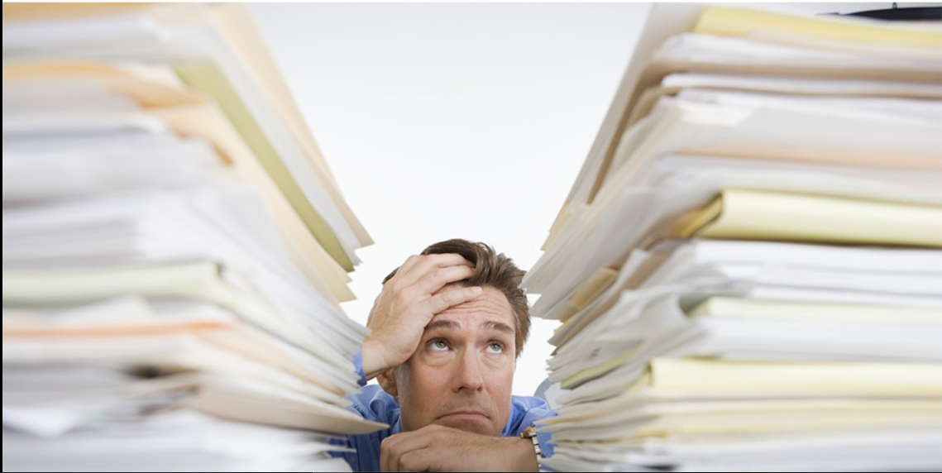
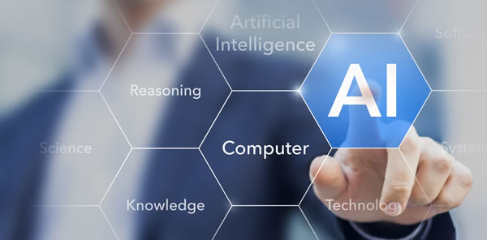
Application
3.Say Good Bye to Paper checking
Save efforts if you need to check 1000s of document
Say hello to A.I

Slide 6

Advantage
You can only get if you Deserve
Come to the point machine ignore irrelevancy
Colorful text has gone write what is needed

Slide 7

Disadvantage
You can get fail is program does not predict well

Slide 8
Used Technology
Python is used as a programming language
Used Tkinter library in Python for GUI.
Used fuzzywuzzy for comparing and training data.

Slide 9
Conclusion
This software is used in many other purpose like
word searching machine,
Removing irrelevancy in document
and Retrieving sort and accurate answers

Slide 10
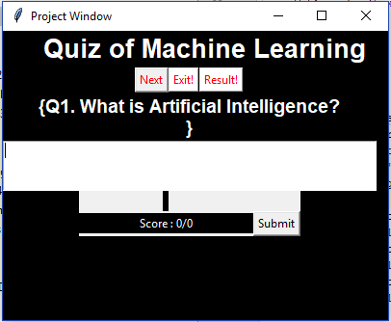
Screen-Shots:

Slide 11
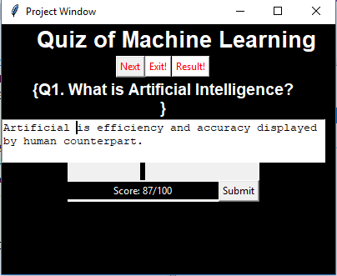

Slide 12
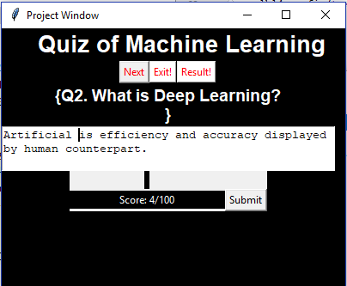

Slide 13
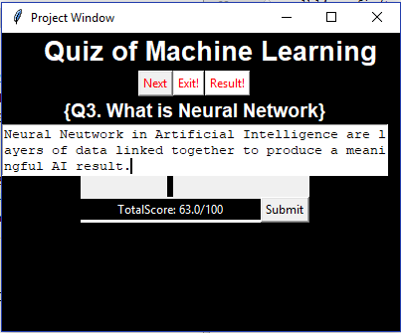

Slide 14
Thank you

